Slide 1



FINAL PROJECT PRESENTATION
Employee Performance & Loan Analysis Dashboard
An Interactive Business Intelligence Dashboard built using Tableau
Presented by: Sudipta Mitra | B.Sc. Data Science

Slide 2



What We’ll Cover
Agenda for today’s final project presentation
01
Introduction & Problem Statement
05
Visualizations & Chart Types
02
Project Objectives
06
Interactive Filters
03
Dataset Description
07
Expected Outcomes & Conclusion
04
Proposed Dashboard Features

Slide 3
Employee Performance & Financial Analytics
Employee performance and financial management play a vital role in organizational success. Businesses collect large volumes of employee data, including salaries, loans, bonuses, performance ratings, and sales records. An interactive dashboard helps convert this raw data into meaningful insights for HR professionals and management.
809
₹909,296
₹273,084,795
3.758
Total Employees
Average Salary (INR)
Total Loan Amount (INR)
Average Performance Rating
12.56%
7.479%
Average Bonus (%)
Average Interest Rate (%)
Source: https://docs.google.com/spreadsheets/d/1LL2yIcGlCc-terHIT2KDfahK8C-YP508/export?format=xlsx

Slide 4
Problem Statement
Census data is rich, but hard to access, interpret and compare
!
i
The Challenge Today
Our Approach
Employee data is stored in spreadsheets.
Manual analysis takes significant time.
Difficult to compare departments.
Performance trends are not easily identified.
Decision-making becomes less efficient.
Develop an interactive Tableau dashboard that transforms employee data into visual insights, enabling quick analysis of performance, salaries, loans, bonuses, and quarterly sales.

Slide 5
Project Objectives
What the dashboard is designed to achieve
Develop an interactive Tableau dashboard.
Analyze employee distribution across departments.
Compare salary and loan amount by department.
Visualize employee performance ratings.
Analyze bonus distribution.
Compare quarterly sales by location.
Identify relationships between bonus percentage and performance rating.
Support data-driven HR and financial decision-making.

Slide 6
Dataset Description
Employee workforce and financial dataset powering the dashboard
Employee Performance Dataset
SOURCE
COVERAGE
FORMAT
Employee Performance & Financial Dataset
Employee-level data across multiple departments and office locations
Structured tabular data
The dataset provides a comprehensive overview of employee information, including department, location, salary, loan details, bonus percentage, performance rating, and quarterly sales. It enables multidimensional analysis of workforce performance, financial metrics, and business operations through interactive visualizations.

Slide 7
Dataset Variables
Key fields captured for each employee record
Employee Name
Department
Location
Hire Date
Salary (INR)
Loan Amount (INR)
Loan Term (Years)
Loan Age (Years)
Interest Rate (%)
Bonus (%)
Performance Rating
Quarterly Sales (Q1, Q2, Q3, Q4)

Slide 8
Dashboard Feature: KPI Cards
At-a-glance summary metrics shown at the top of the dashboard
Total Employees – 809
Average Salary (INR) – ₹909,296
Average Performance Rating – 3.758
Average Bonus (%) – 12.56%
Average Interest Rate (%) – 7.479%
Each KPI card surfaces a single headline number, refreshed instantly as filters change.

Slide 9
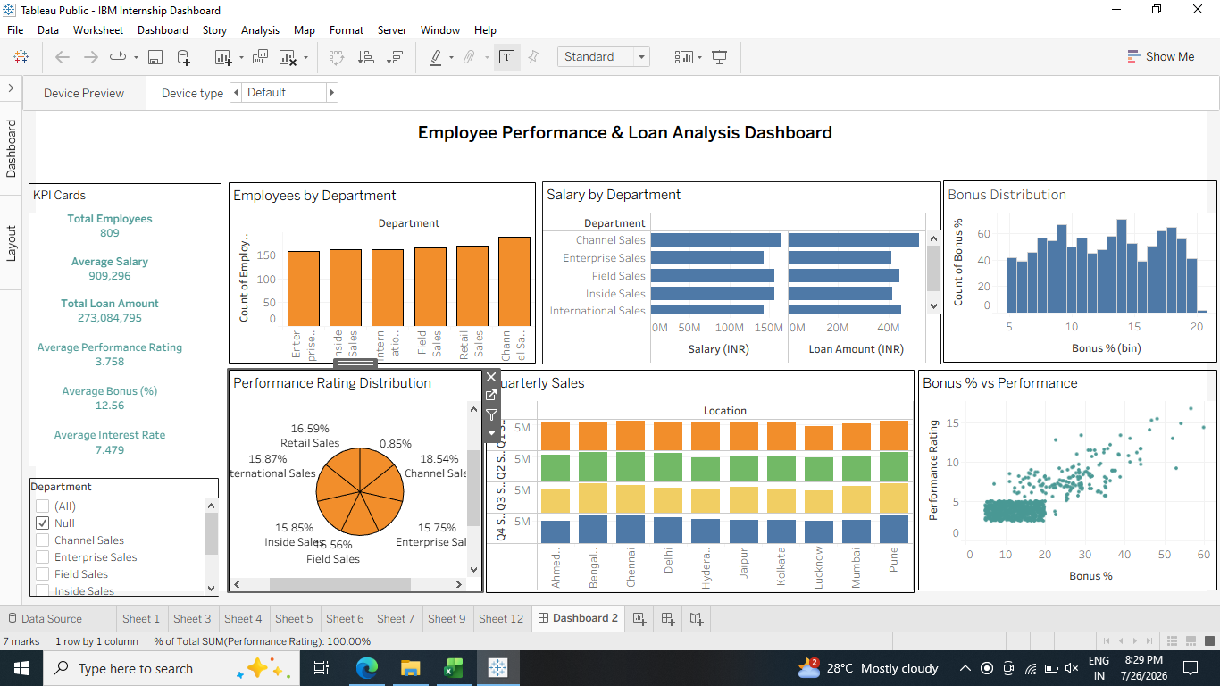
Dashboard Features: Map & Charts
Geographic and comparative views of the data
Horizontal Bar Chart
Bar Charts
Salary & Loan Amount by Department
Compares total salary and loan amount across departments to evaluate financial allocation and employee loan trends.
Employees by Department
Displays the number of employees in each department, enabling comparison of workforce distribution across the organization.

Slide 10
Dashboard Features: Map & Charts
Geographic and comparative views of the data
Histogram
Pie Chart
Bonus Distribution
Shows the frequency distribution of employee bonus percentages, highlighting common bonus ranges and variation.
Performance Rating Distribution
Illustrates the percentage distribution of employee performance ratings across different departments.

Slide 11
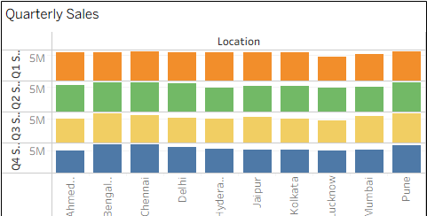
Dashboard Features: Map & Charts
Geographic and comparative views of the data
Stacked Bar Chart
Scatter Plot
Quarterly Sales by Location
Compares quarterly sales (Q1–Q4) across office locations, helping identify regional sales performance and trends.
Bonus % vs Performance Rating
Visualizes the relationship between bonus percentage and performance rating, helping assess whether higher-performing employees receive higher bonuses.

Slide 12
Live Dashboard Demonstration
Geographic and comparative views of the data
https://public.tableau.com/app/profile/sudipta.mitra5174/viz/IBMInternshipDashboard/Dashboard2
Link

